Slide 1
Facility Hire Brochure
2020

Slide 2
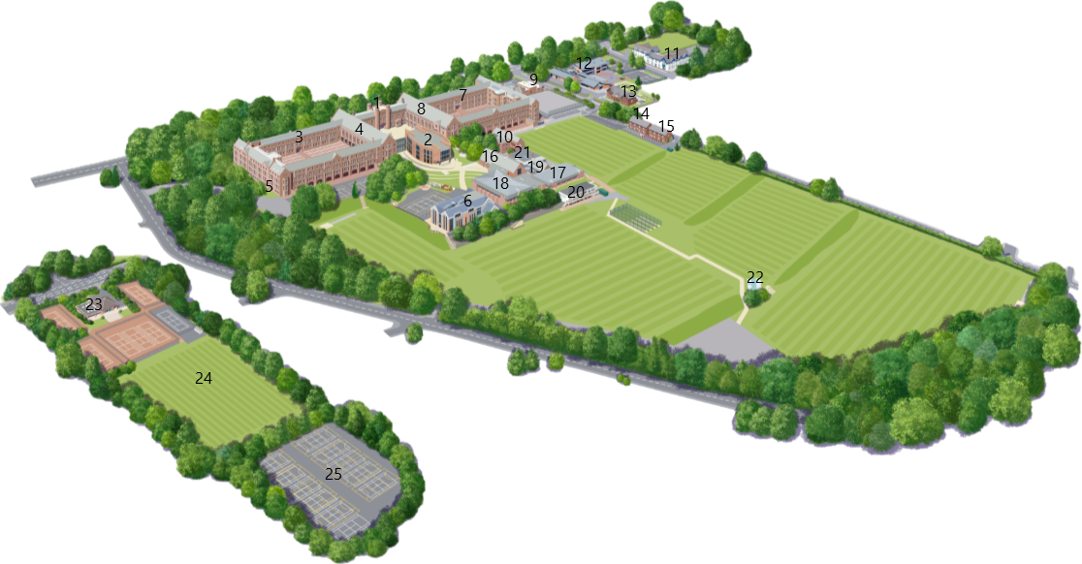
Bolton School Campus
Click on our video for an overview of Bolton School campus!
1. Centre Arch and Main Entrance
2. The Riley Sixth Form Centre, Reception and Security
3. Girls' Division
4. Girls’ Division Girls’ Division Great Hall
5. Girls’ Division Dining Hall
6. Girls’ Division Junior School (Hesketh House)
7. Boys’ Division
8. Boys’ Division Great Hall
9. Boys’ Division Dining Hall
10. Boys’ Division Kroto Chemistry Building
11. Boys’ Division Junior School (Park Road)
12. Infant School (Beech House)
13. Bolton School Nursery
14. Kidzone Wraparound Childcare and Nursery Class
15. School Uniform Shop (Monkhouses)
16. Arts and Conference Centre
17. Swimming Pool
18. Sports Hall
19. BSSL Events & Lettings Office
20. Tillotson Pavilion & Fitness Centre
21. Sports Changing Rooms
22. Green Pavilion
23. Leverhulme Pavilion
24. Leverhulme All-Weather Pitch
25. Leverhulme Netball Courts

Slide 3
Sports Hall
Our recently refurbished Sports Hall is equipped with a variety of markings for a range of indoor sports. Spectators are welcome to watch from our viewing gallery.
Full Court £43.00
Half Court £25.00
Badminton Court £11.00
Cricket Lane £25.00
2 or more Cricket Lanes £50.00
All prices listed above are for 1 hour and not subject to negotiation.

Slide 4
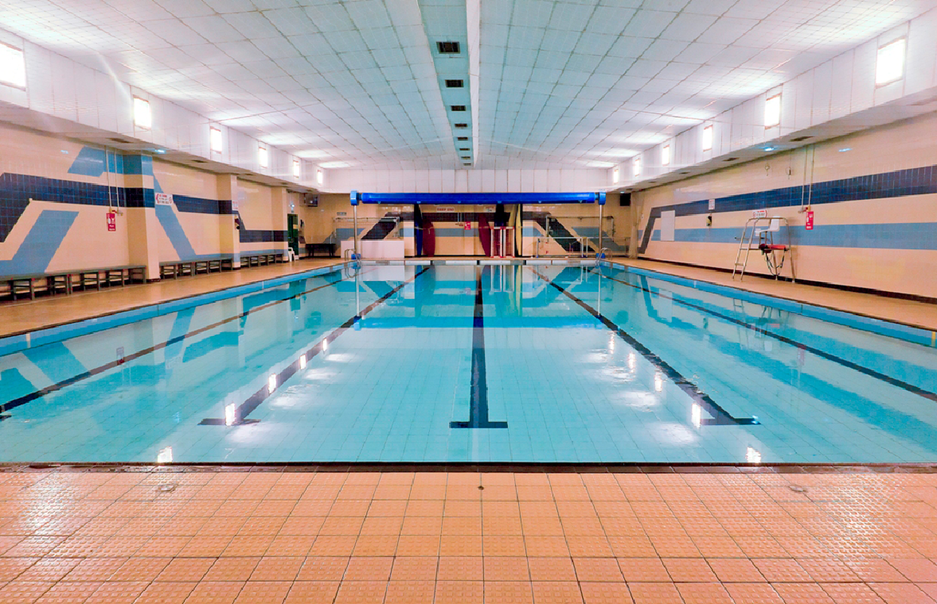
Swimming Pool
The Swimming Pool is 25m, has 5 lanes and is equipped for water polo matches and swimming galas. The depth of the pool ranges from 0.9m to 2m.
Pool Hire £55.00
Single Lane £7.50
Public Swim
Adult Entry £4.50
Public Swim
Junior Entry £1.90
All prices listed above are for 1 hour and not subject to negotiation.

Slide 5
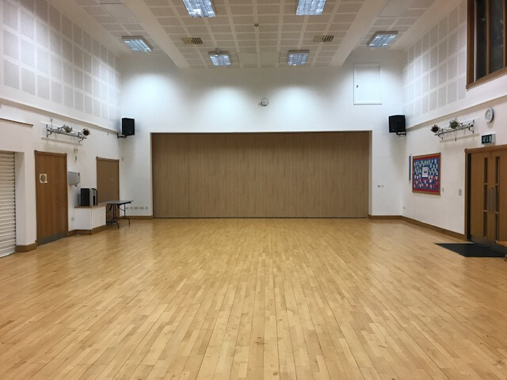
Hesketh House
Located in the Girls' Junior School the hall is ideal for birthday parties, yoga and dance classes. A stage is situated at one end of the hall.
Hall Hire £25.00
All prices listed above are for 1 hour and not subject to negotiation.

Slide 6
Leverhulme
All-weather Astro
Our state-of-the-art all-weather 3G pitch is located off-site of the main school complex. The facility includes markings for football, hockey and lacrosse, run-offs, dug-outs, a spectator area, floodlights changing rooms and parking. The pitch can be split into halves and thirds.
Click on our video for an overview of the Leverhulme Pavilion and pitch!
Full Pitch £50.00
1/3 Pitch £35.00
All prices listed above are for 1 hour and not subject to negotiation.

Slide 7
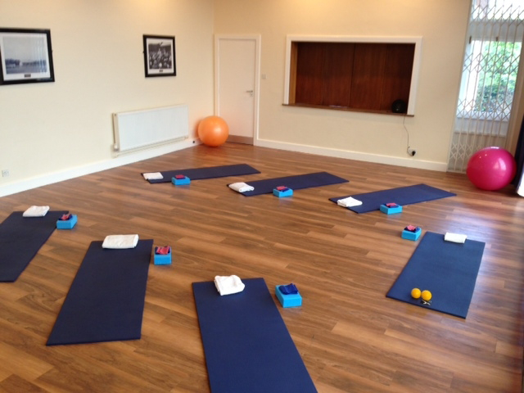
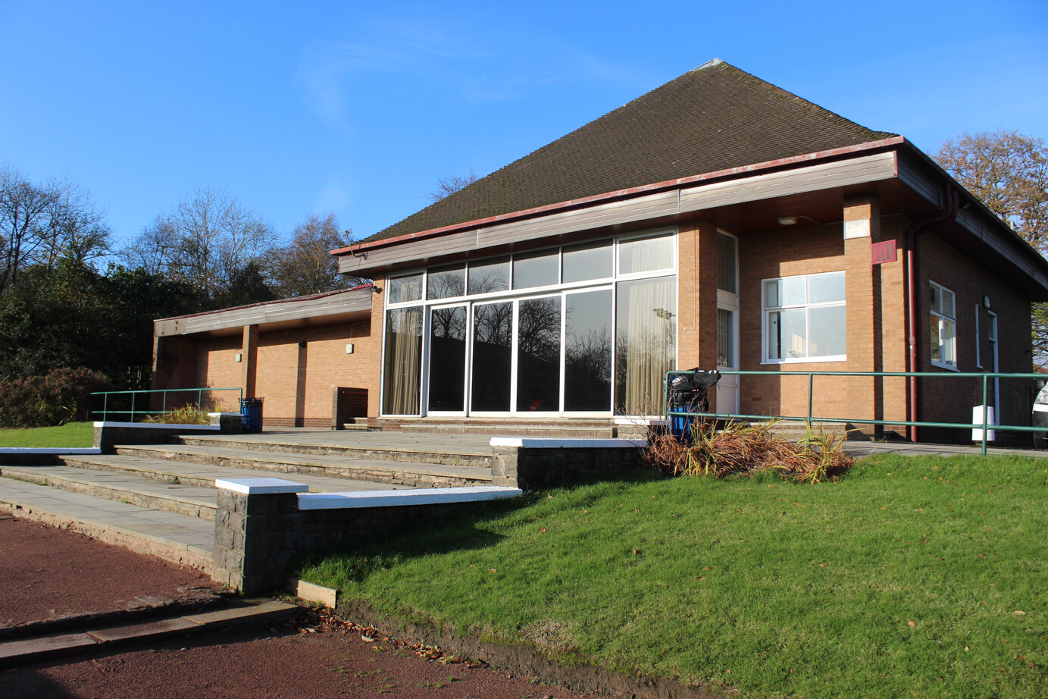
Leverhulme
Pavilion
Situated next to our all-weather pitch, Leverhulme Pavilion is the ideal space for yoga and dance classes. The class partition allows for stunning views across the grounds.
Hall Hire £25.00
All prices listed above are for 1 hour and not subject to negotiation.

Slide 8
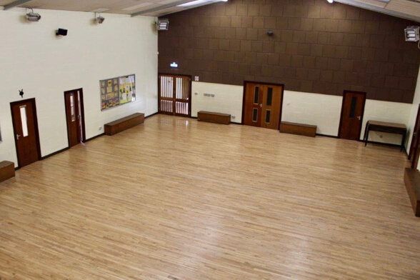
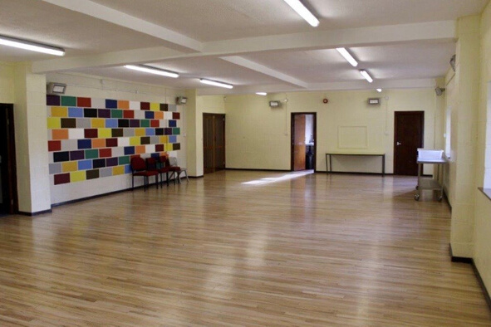
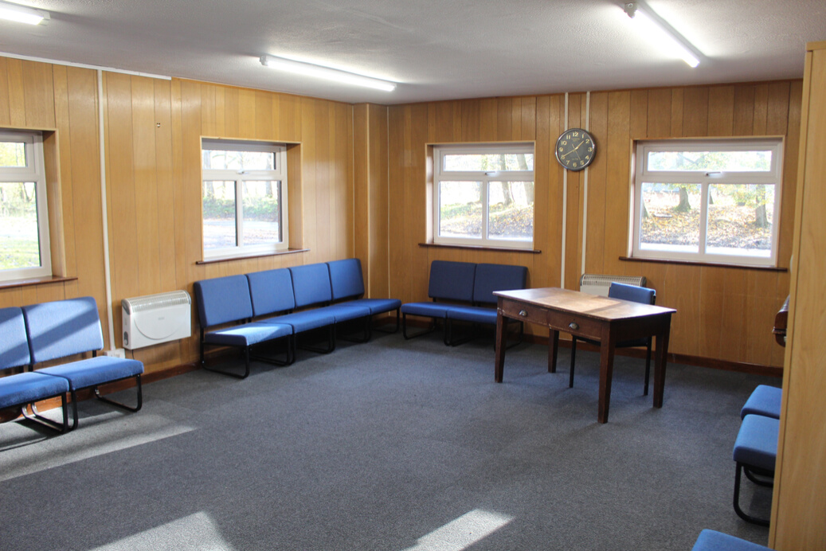
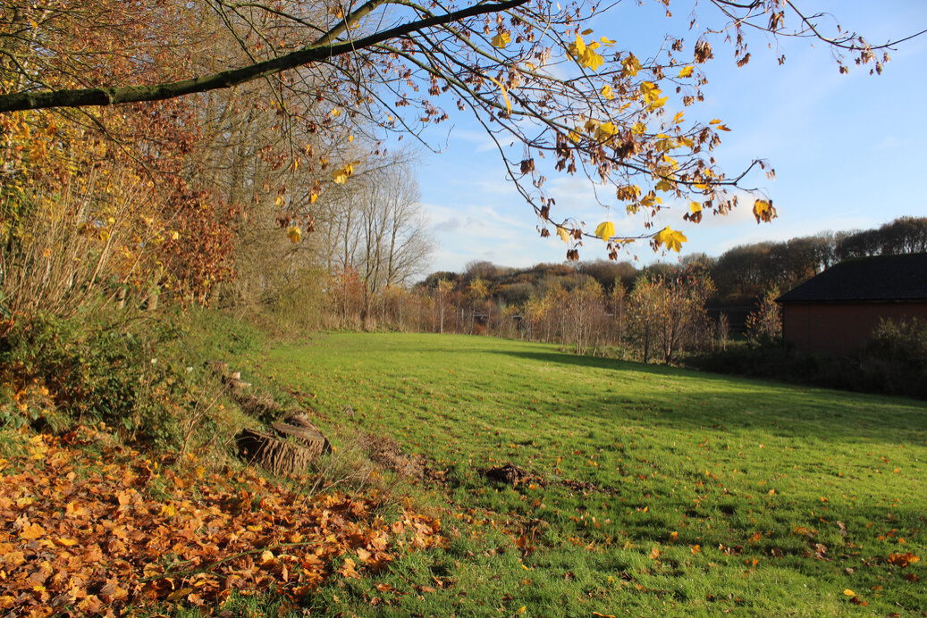
Brookside
Pavilion
Brookside Pavilion is located in overlooking the peaceful countryside. Equipped with 2 halls, classrooms, kitchens and a playing field, Brookside Pavilion is ideal for a variety of sporting and social clubs and events.
Large Hall £50.00
Two Halls £25.00
Classroom £15.00
Ground Floor £80.00
All prices listed above are for 1 hour and not subject to negotiation.

Slide 9
Netball Courts
Next to our all-weather astro pitch is 8 asphalt Netball courts; ideal for Summer evening practice. Alternatively, the quad is also marked and equipped for tennis and hockey.
Netball Court £30.00
All prices listed above are for 1 hour and not subject to negotiation.

Slide 10
For enquiries on dates and times, or for more information please contact:
Telephone: 01204 434797
Email: info@bssleisure.com
Web: https://www.bssleisure.com/
/bssleisure
@bssleisure
@bssleisure

